Slide 1
Integrated Project-I
CricInfo
Submitted By
Name: Ankush Sharma
Name:Arsh Bhardwaj
Name:Anmoldeep Singh
Name:Anish
University ID:
2111981038,2111981050,
2111981041,2111981032
Department of Computer Science & Engineering
Supervisor
Under the Guidance Of
Name: Dr. Abhishek Thakur
Designation:
Department of Computer Science & Engineering
Chitkara University, Himachal Pradesh

Slide 2
Introduction to CricInfo
Welcome to our cricket website! Here, you'll find everything you need to know about the exciting world of cricket, including scores, and updates on your favorite teams and players. Whether you're a die-hard fan or a newcomer to the sport, our website has something for everyone. We strive to provide in-depth analysis, insightful commentary, and comprehensive coverage of cricket matches around the globe. So, join us on this thrilling journey and immerse yourself in the fascinating world of cricket.

Slide 3
OVERVIEW OF FRONT PAGE
On top left corner Our site logo will be present.
At centre buttons will be present like international, domestic, sign up, login.
At centre a quote will be present inside a slideshow.
At bottom a contact us button will be present to inform us about any kind of website failure.

Slide 4
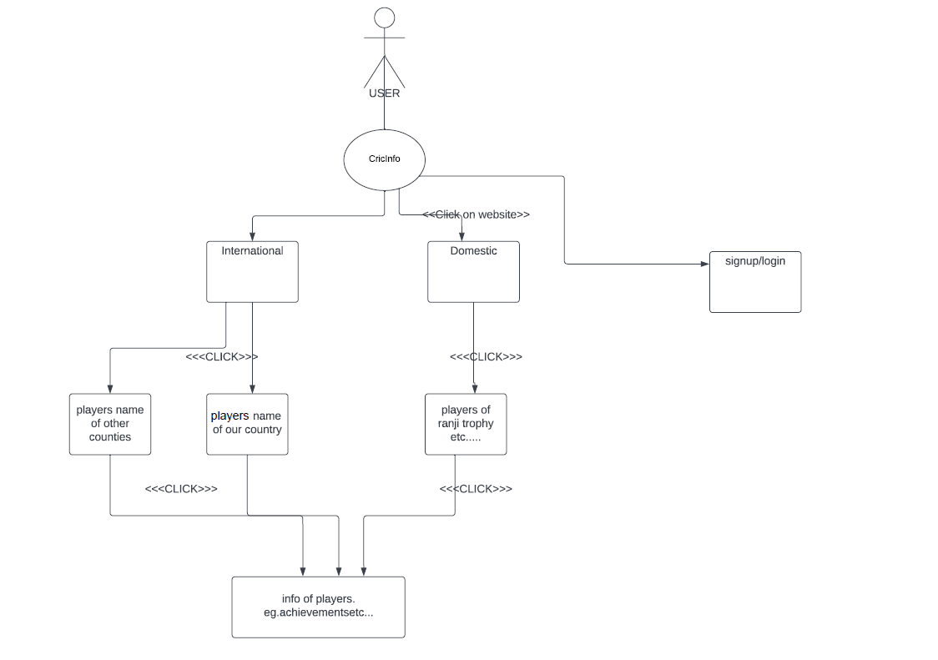
FLOWCHART

Slide 5

FRONT PAGE VIEW

